Slide 1
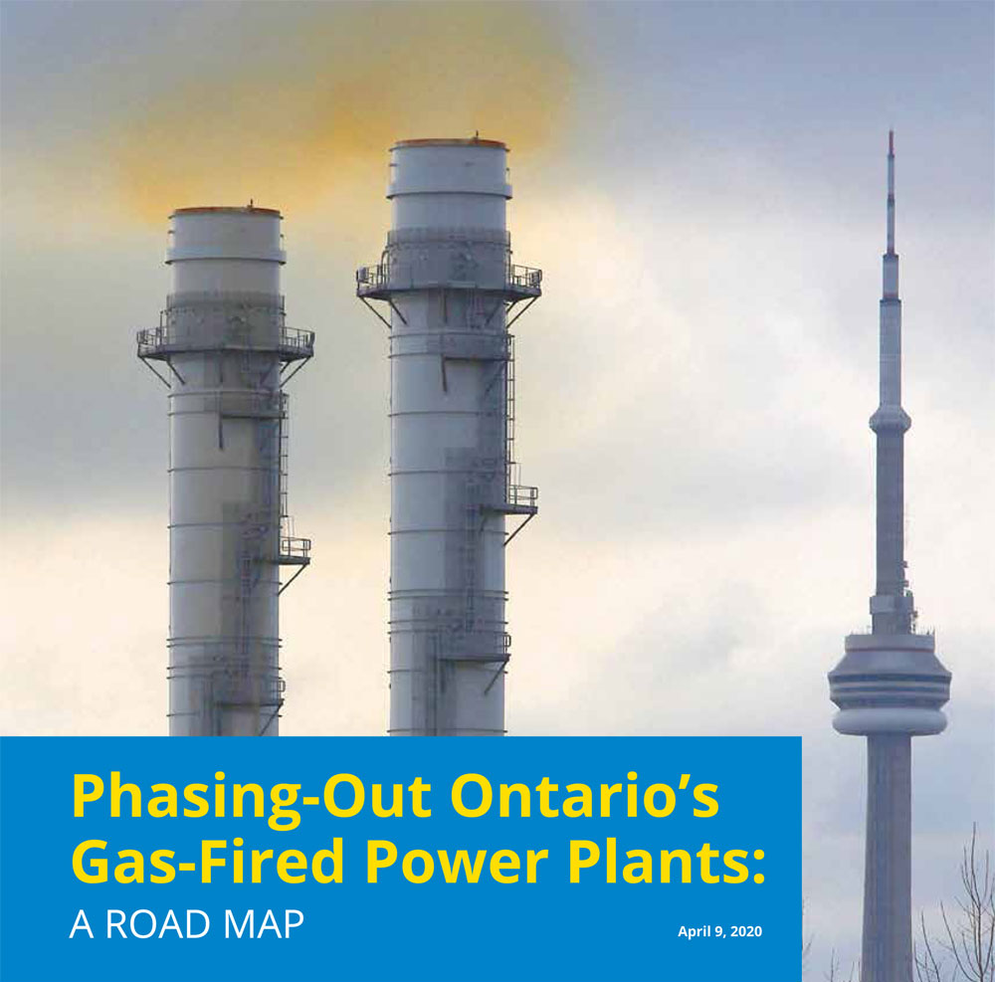


Slide 2
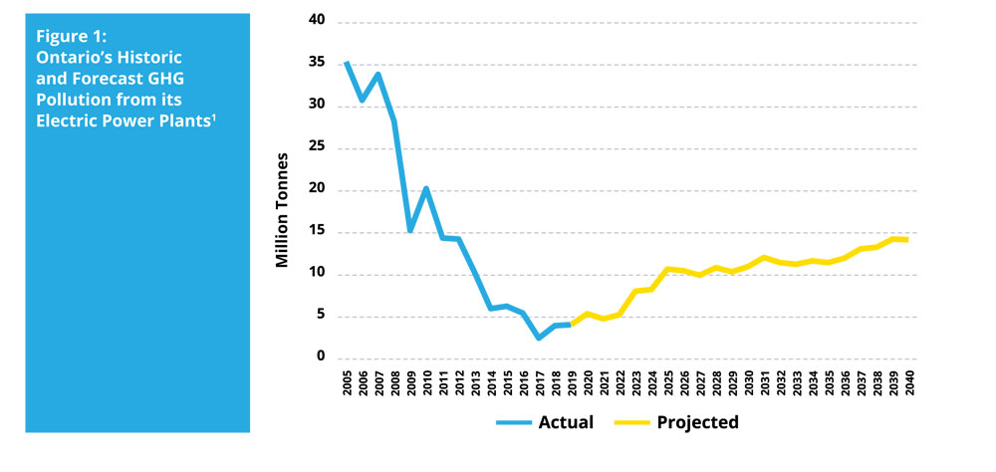
Ontario’s rising emissions
Megatonnes
(IESO)

Slide 3
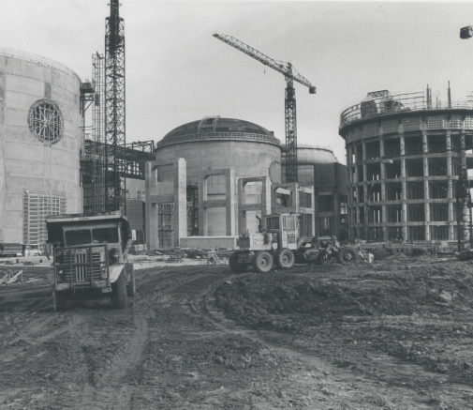
What’s behind these rising emissions?
Ontario’s demand for electricity will rise by about 1% per year.
The Pickering Nuclear Station will close in 2024.
Virtually all of our need for new electricity resources will be met by ramping up province’s gas-fired power plants.

Slide 4
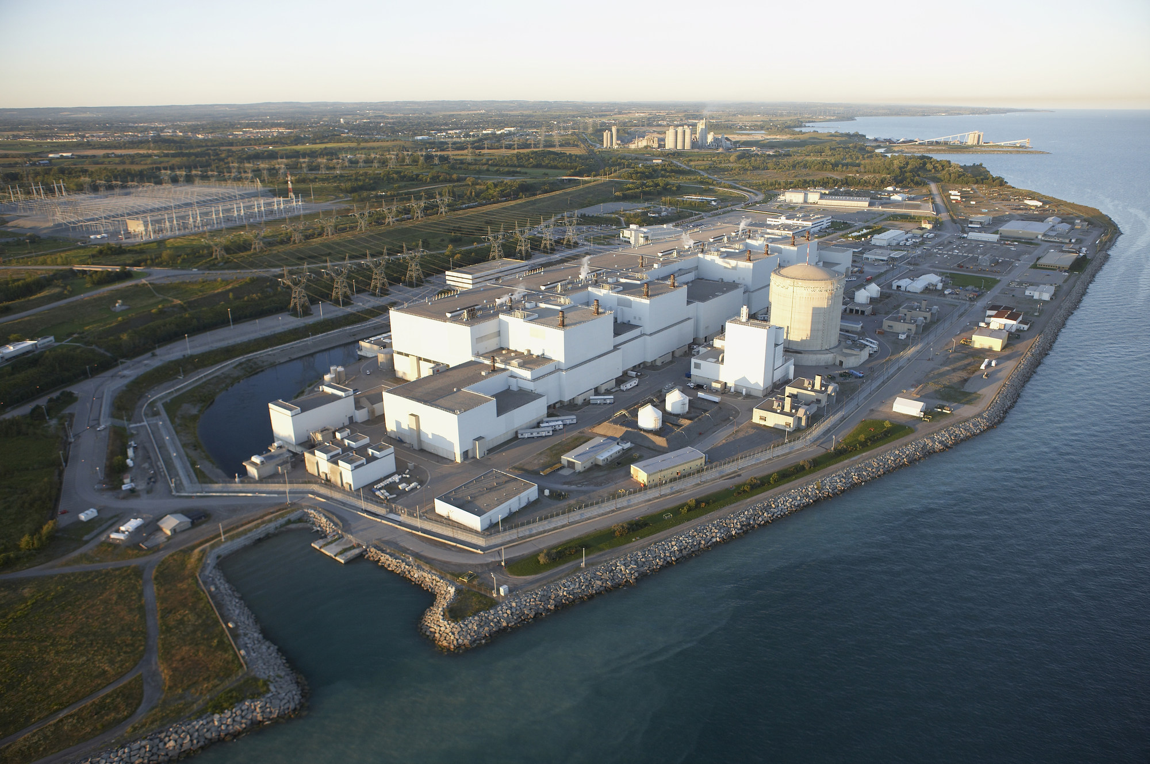
The Ford Government’s Electricity Plan
The Ford Government’s plan does not include:
Any new energy efficiency investments to reduce electricity demand post-2020
Any new electricity supply agreements with Hydro Quebec; or
Any new investments in Made-in-Ontario renewable electricity projects.
Ramping up the output of the province’s existing gas-fired power plants;
Re-building 10 of Ontario’s aging nuclear reactors at a forecast cost of $25.8 billion
Working with New Brunswick and Saskatchewan to develop and deploy small modular nuclear reactors; and
Upgrading Hydro One’s transmission system to enable it to import up to 1,650 megawatts (MW) of firm power from Quebec by December 2022.

Slide 5

Enbridge’s Proposed Hamilton Pipeline
To facilitate ramp-up of Ontario gas plants
To deliver Pennsylvania fracked gas to Maine and New Hampshire.
Will raise rates of Ontario gas consumers by $120 million

Slide 6
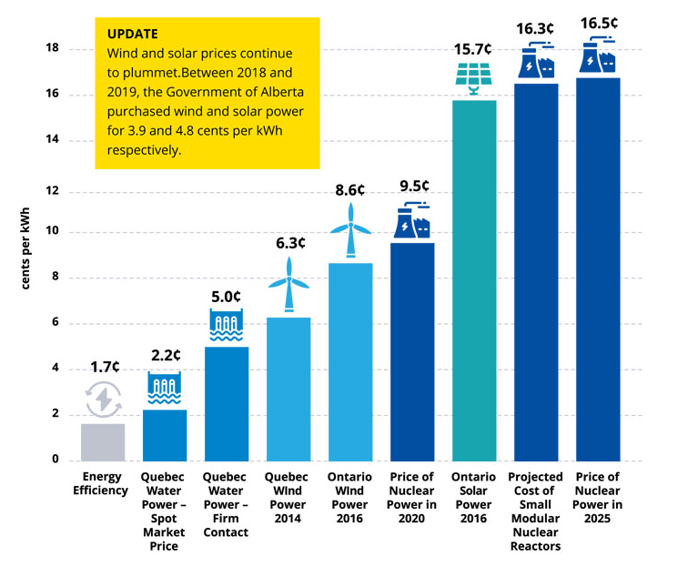
How Ontario can phase-out its gas plants and lower our electricity bills

Slide 7
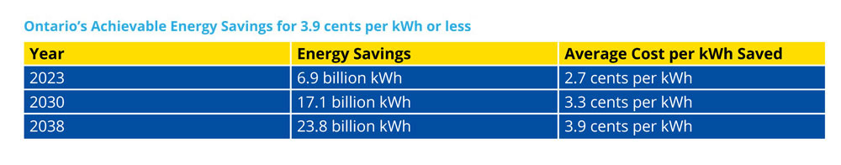
Our Energy Efficiency Potential
17.1 billion kWh is equivalent to 60% of the forecast output of Ontario’s gas plants in 2030.
23.8 billion kWh is equivalent to 68% of the forecast output of Ontario’s gas plants in 2038.

Slide 8

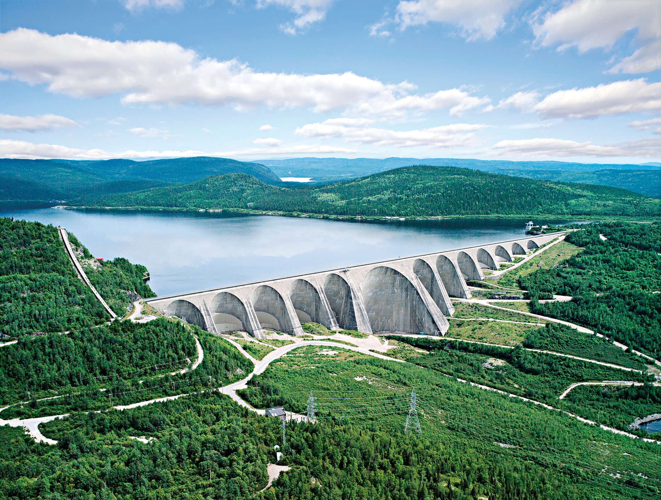
“Quebec generates a large surplus of electricity, primarily from emissions- free hydroelectric generating stations, and electricity prices in Quebec are the lowest in Canada. The proximity of Quebec to Ontario’s major cities presents an attractive opportunity for Ontario to meet its electricity needs with imports from Quebec.”
- Financial Accountability Office of Ontario

Slide 9
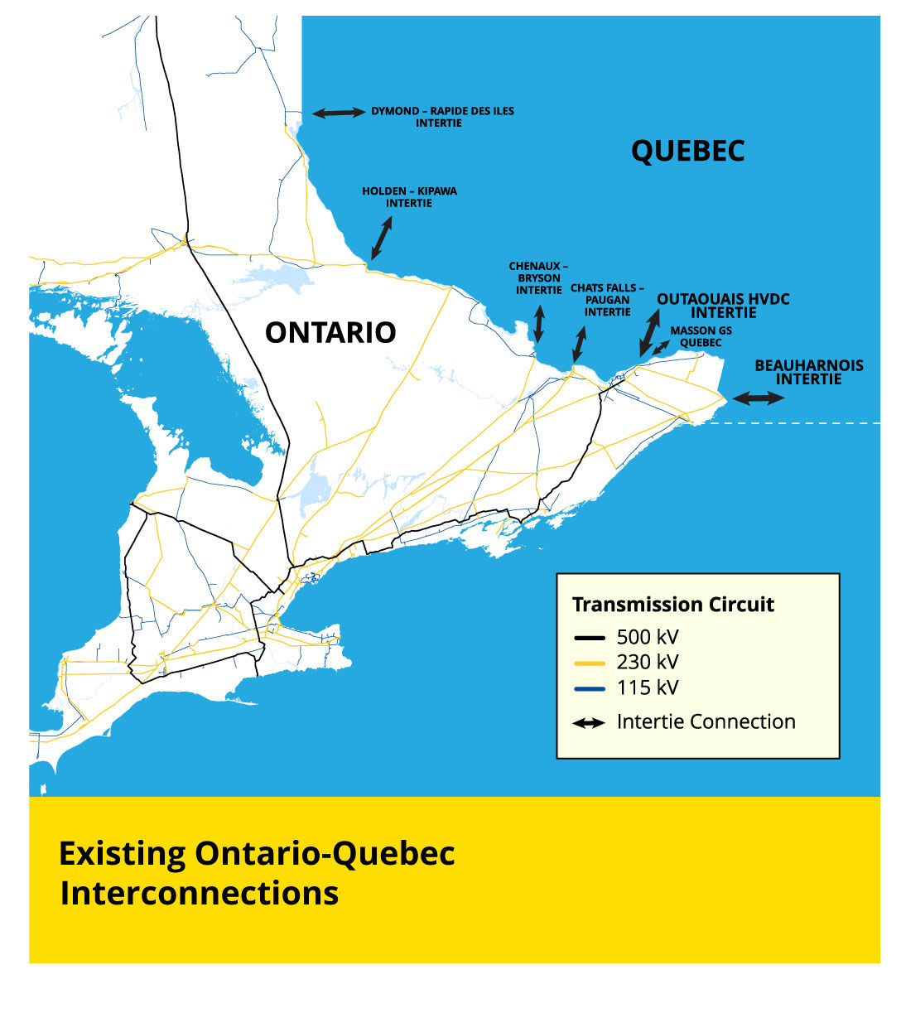
Expanding Quebec Imports
Ontario can import 16.5 to 18.5 billion kWh per year from Quebec with existing transmission links.
In 2019 we imported only 5.4 billion kWh.
So we can increase our imports by up to 13.1 billion kWh, which is equivalent to 45% of Ontario’s forecast gas-fired generation in 2030.

Slide 10
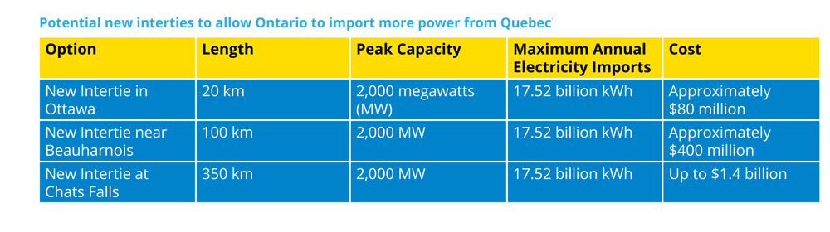
Adding Import Capacity
If just one of these interties was built, our total import capability would rise to approximately 35 billion kWh per year, which would be equivalent to 122% of Ontario’s forecast gas-fired generation in 2030.

Slide 11
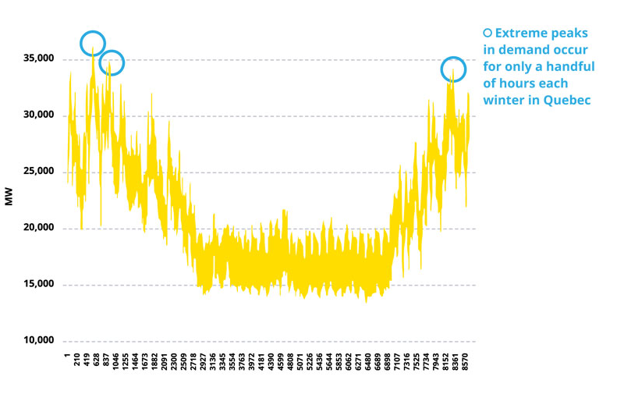
Quebec has the power
Quebec has surplus power available for at least 99% of the hours of the year.
Nuclear generating stations are not available for 100% of hours of the year.
Darlington Nuclear Station’s average annual capacity factor is only 83%.

Slide 12
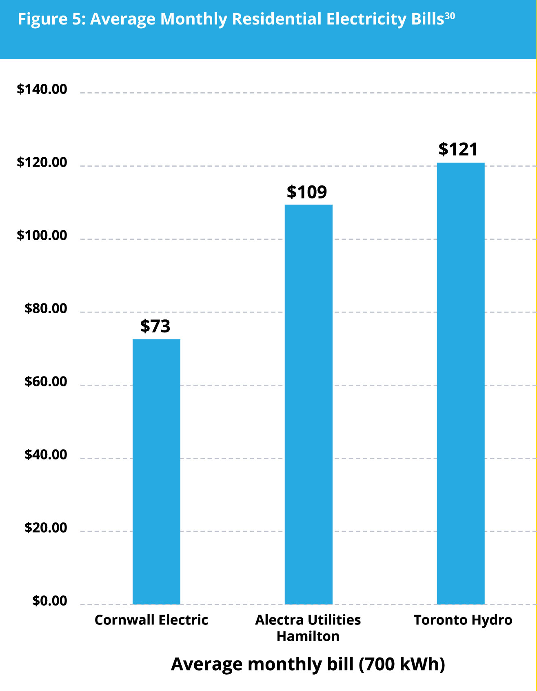

Cornwall gets 100% of its electricity from Quebec

Slide 13
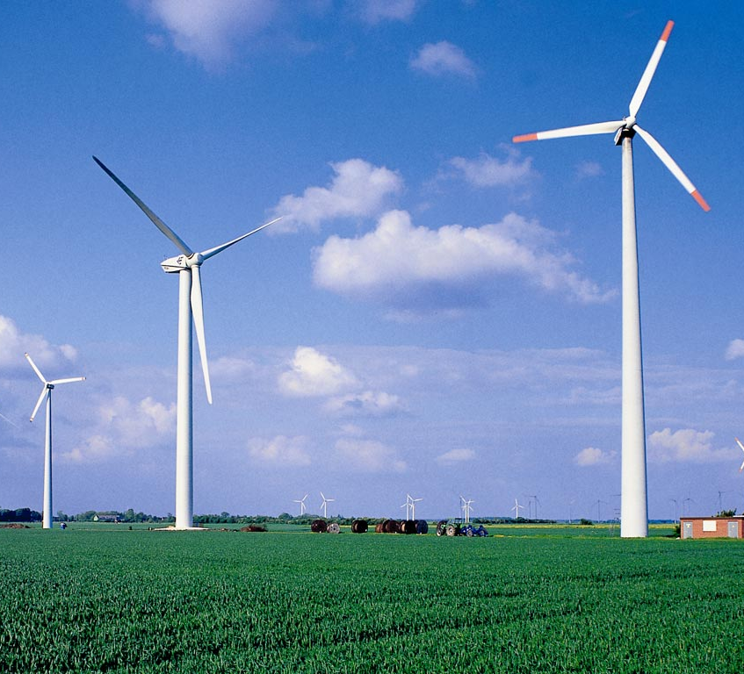
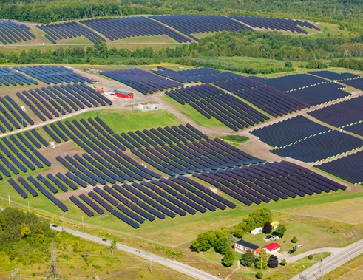
Ontario wind and solar
Ontario has large potential supply of wind and solar energy.
Off-shore wind in Great Lakes could produce 111.5 billion kWh per year, which is equivalent to 82% of Ontario’s annual electricity consumption.
Since wind doesn’t always blow and sun doesn’t always shine, these options must be combined with storage systems if they are to displace gas generation during every hour of the year.
According to a Massachusetts Institute of Technology (MIT) study, Hydro Quebec’s existing hydro-electric reservoirs are the best storage (load balancing) option for New England and New York wind and solar energy.
Working with Quebec is also a way for Ontario to cost-effectively achieve a zero carbon grid.

Slide 14
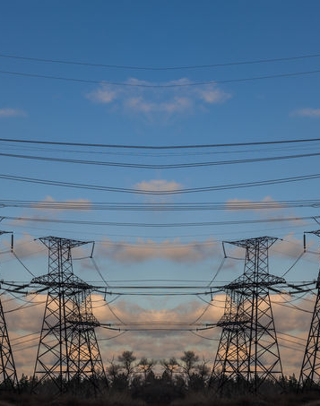
Stopping gas-fired exports
In 2019 Ontario’s gas plants exported 3.4 billion kWh of electricity.
That is, 35% of their total output was exported.
We can reduce our greenhouse gas pollution by curtailing our exports of gas-fired generation.

Slide 15
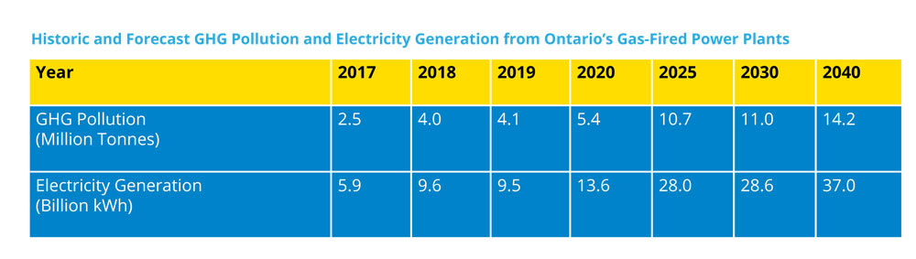
Reaching Ontario’s 2030 Climate Target
According to Ontario’s Auditor General, we need to implement measures that will reduce our greenhouse gas pollution by an additional 7.3 to 14 million tonnes per year to achieve our 2030 climate target.
A phase-out of Ontario’s gas plants would provide our province with all or virtually all of the incremental pollution reductions that it needs to achieve its 2030 climate target.

Slide 16
How Ontario can phase out gas
1. Direct the Independent Electricity System Operator (IESO) to maximize its spot market purchases of Quebec waterpower before it dispatches gas-fired generation.
2. Direct the IESO to stop its spot market gas-fired electricity exports (except for emergency exports).
3. Direct the IESO to pay residential, commercial, institutional and industrial consumers up to the price of nuclear electricity (e.g., 9.5 cents per kWh in 2020) for each kWh they save by investing in energy efficiency.
4. Direct Hydro One to build a new 20 km transmission line in Ottawa, to increase our ability to import Quebec power by 17.5 billion kWh per year, at a cost of approximately $80 million.
5. Direct the IESO to seek to negotiate long-term electricity supply and storage (load balancing) contracts with Hydro Quebec to help phase-out our gas plants and to meet our electricity needs at a lower cost than re-building up to 10 nuclear reactors.
6. Put a moratorium on the re-building of our aging nuclear reactors while the IESO seeks to negotiate long-term electricity supply and storage contracts with Hydro Quebec.
7. Direct the IESO to purchase Made-in-Ontario wind and solar power that can keep our lights on at a cost that is less than the price of nuclear electricity (e.g., 9.5 cents per kWh in 2020).

Slide 17


Making it happen
We need strong leadership from our municipal councils and provincial opposition leaders.
Ask your municipal council, Andrea Horwath and Steven Del Duca to call for the phase-out of Ontario’s gas plants by 2030; and an interim 2.5 million tonne per year cap on the gas plants’ GHG pollution asap.
Sign our petition: OntarioClimateAction.ca

Slide 18
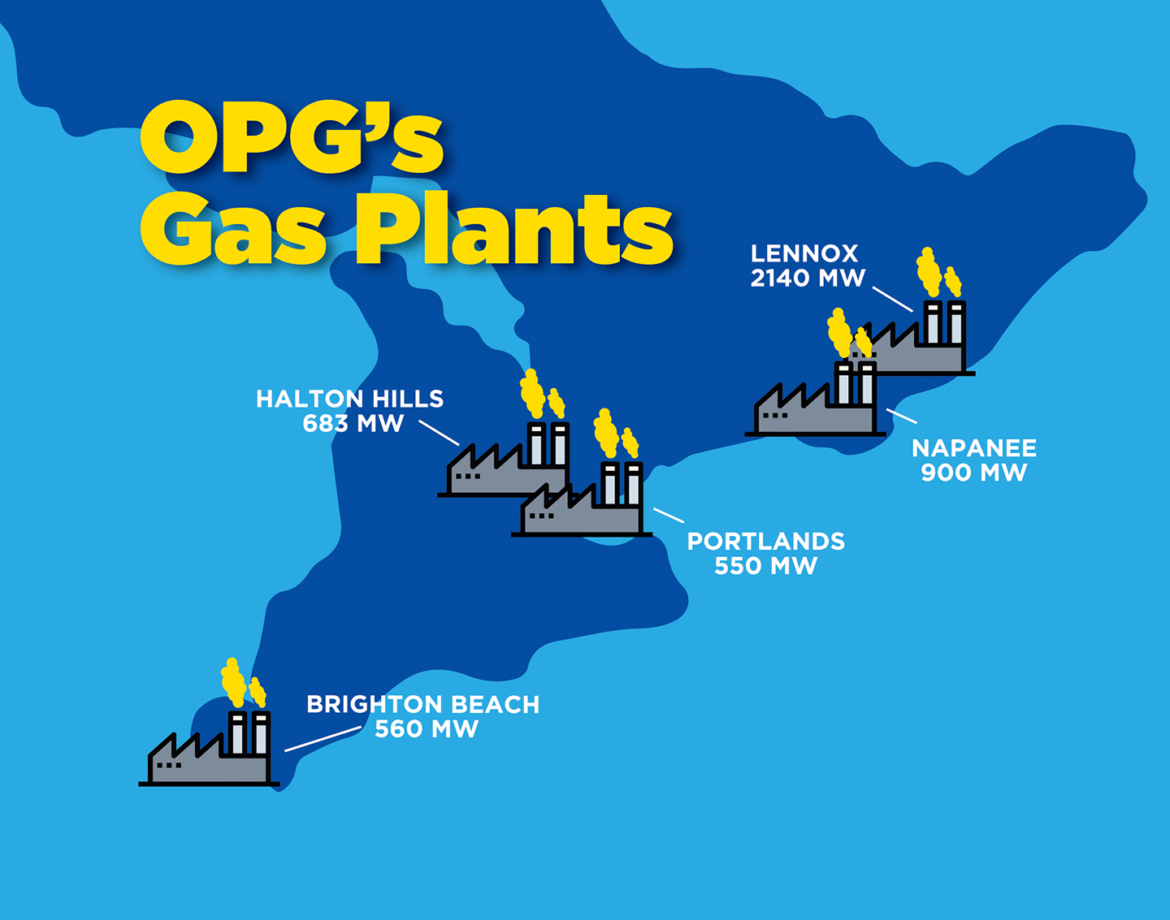

Slide 19
Let’s get to work!
Jack Gibbons
jack@cleanairalliance.org
Angela Bischoff
angela@cleanairalliance.org
CleanAirAlliance.org
OntarioClimateAction.ca

